Slide 1
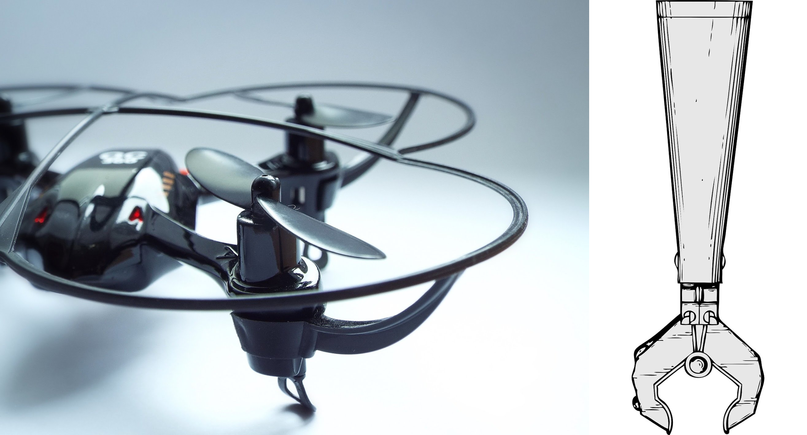
AMDRONE
Jianbo Pei, Ryan(Haoyuan) Wang
ELEG499 Spring Final Presentation
May 11, 2017

Slide 2
Outline
Objective of the Project
Tasks Done from Last Semester
Tasks Accomplished in This Semester
Prototype Demo
Notes:
First, we have our outline of today’s presentation.
We will start with our object of the project, the objective is a pretty easy concept. We are building a robotic arm and a quadcopter. So we add them together, then we have our project here.
And we will talk about tasks done from last semester, and what we have accomplished based on the results from last semester. This semester, we have rebuilt a new robotic arm and shifted from a pre-built quadcopter to a self-built quadcopter.
We will introduce the details of the work we did.
Last, we will have a prototype demo, we will present our final product of this project.

Slide 3
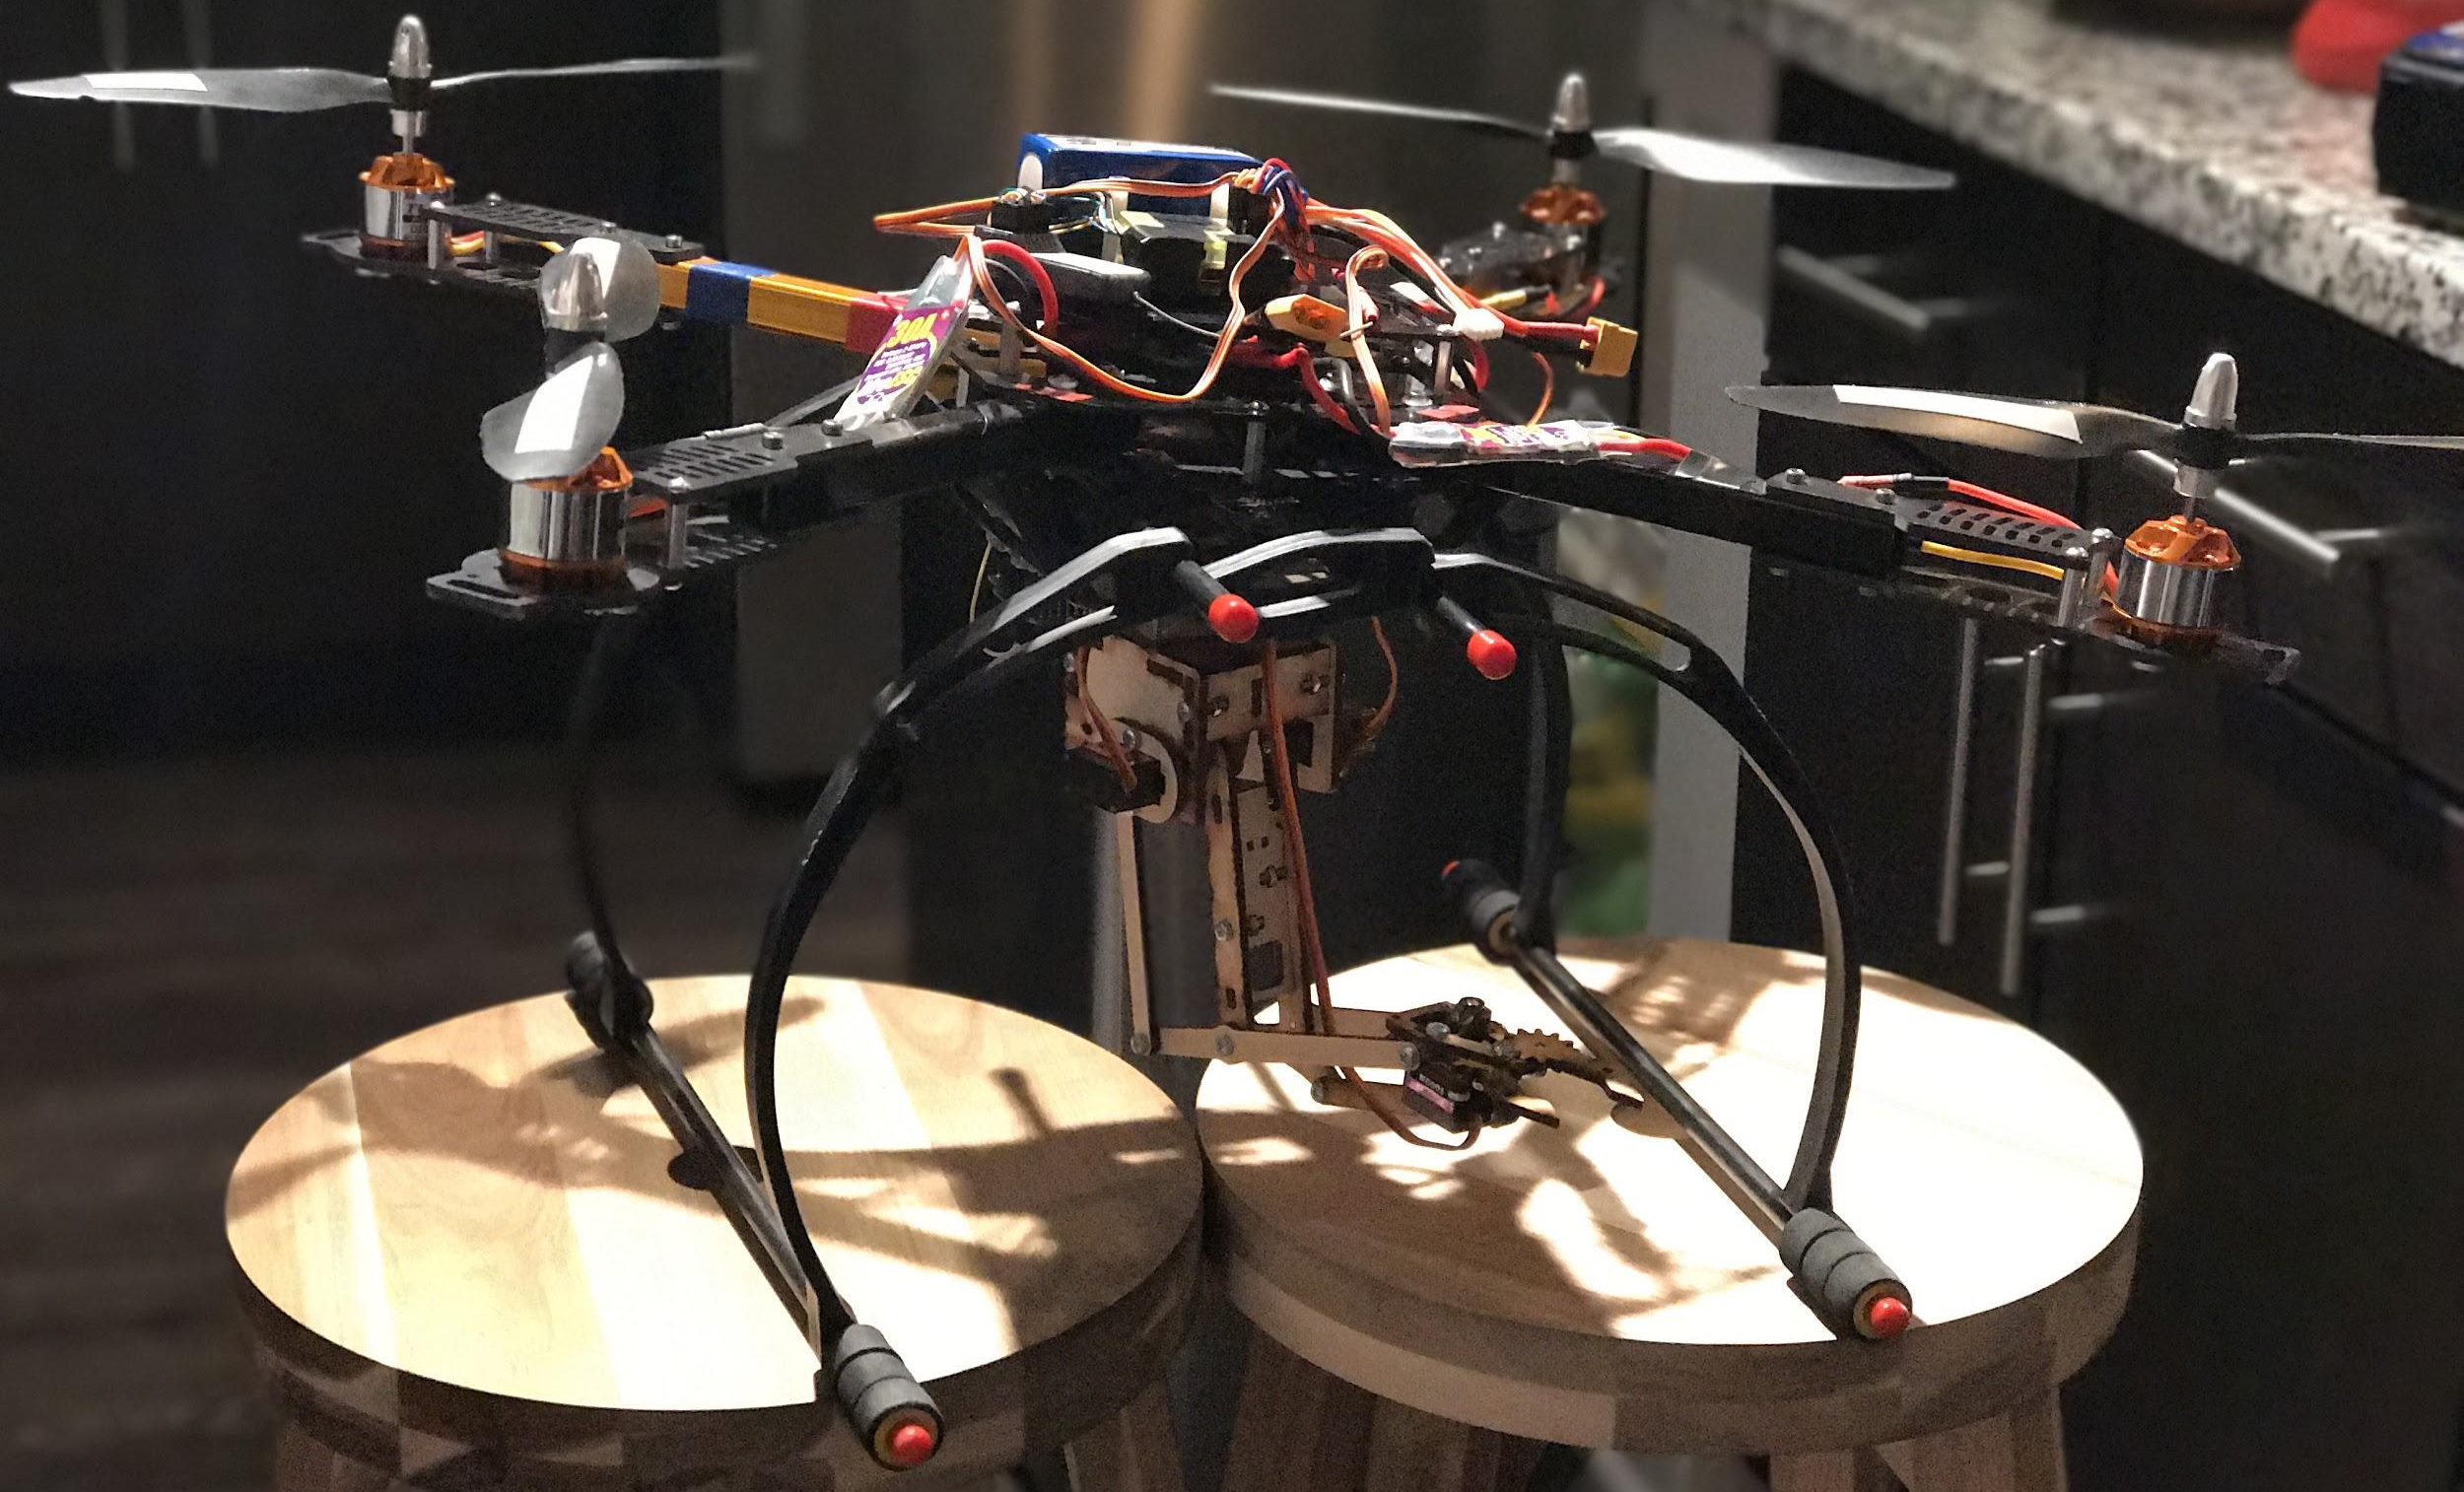
Objective of the project
Design and build a wireless controlled mechanical arm on a quadcopter.
Move object to a designated location by using the robotic arm and the quadcopter.
Problem addressed: Shipping Companies, Police/Army
Notes:
What we are doing here is to design and build a wireless controlled mechanical arm on a quadcopter. And we can control these two components to move object to a designated location by using the robotic arm and the quadcopter.
Our problem addressed here is for shipping carrier companies to have a cheaper method to delivery packages, and for police and army to have a safer way to remove hazardous objects.

Slide 4
Tasks Done in Last Semester (details later)
Designed the basic structure of the whole project
Planned approaches
Constructed a plastic robotic arm called MeArm
Learned and tested fly a pre-built quadcopter

Slide 5
Basic Design of the Whole Project
Overall System: Components Controlled by Microcontrollers
CC3D: Quadcopter
Arduino Uno: Robotic Arm
Interface
Arduino IDE Software
LibrePilot Ground Control Station
Transmission
2.4GHz Radio Signal
Radio Transmitter
Quadcopter &
Sensors
Computer
CC3D
USB
PMW
Arduino Uno
USB
Robotic Arm
PMW
XBOX controller

Slide 6
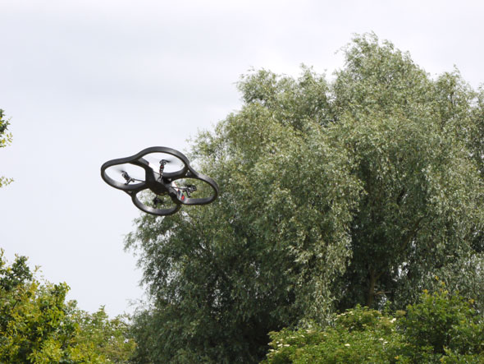
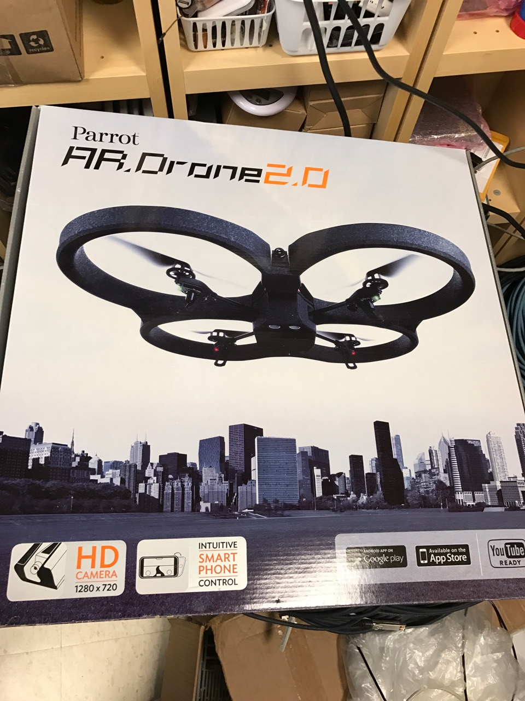
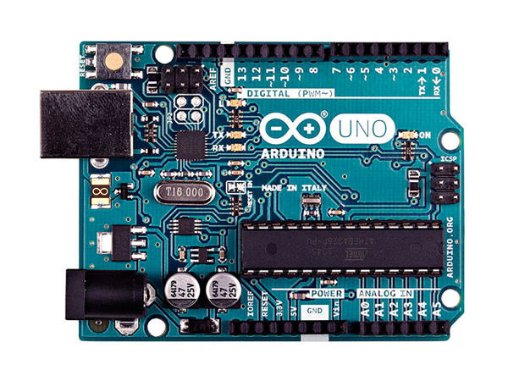
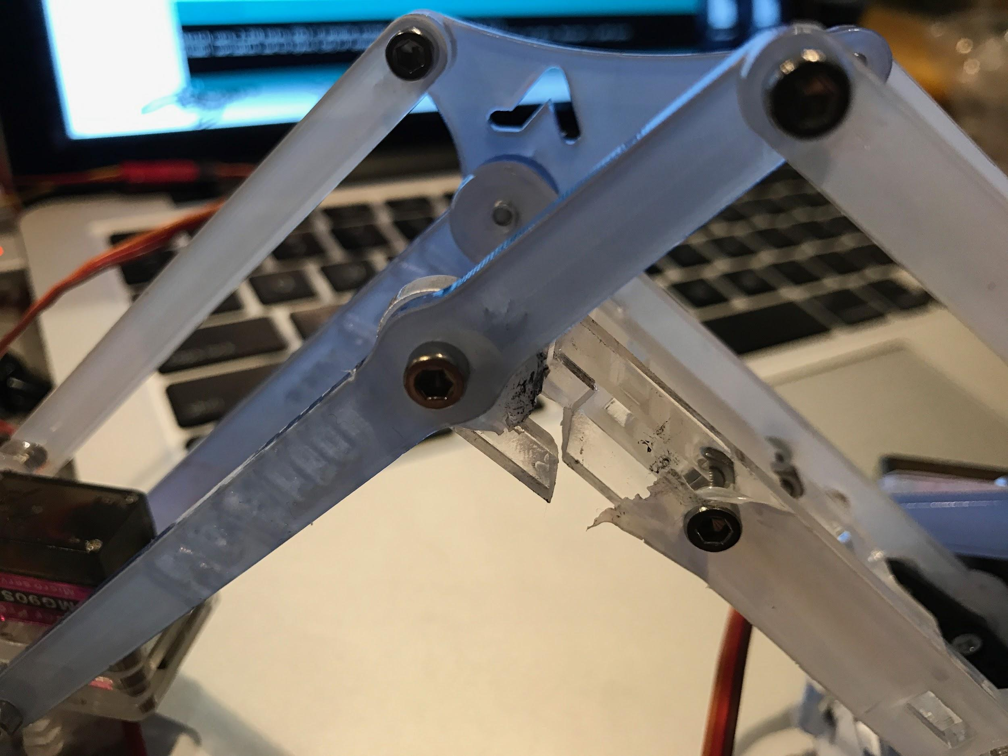
Approaches from last semester
Quadcopter
Parrot AR.Drone 2.0
Problems:
Not steady even with no weight carried
Maximum weight carrying: 0.5lb
Robotic Arm
4 DOF Controlled by Arduino Uno
MeArm:
coded with Python Pyserial
control the robotic arm using computer

Slide 7
Tasks Done in This Semester
New robotic arm
Control robotic arm by new techniques
Shift to a new self-built Quadcopter
Integrate quadcopter and robotic arm

Slide 8
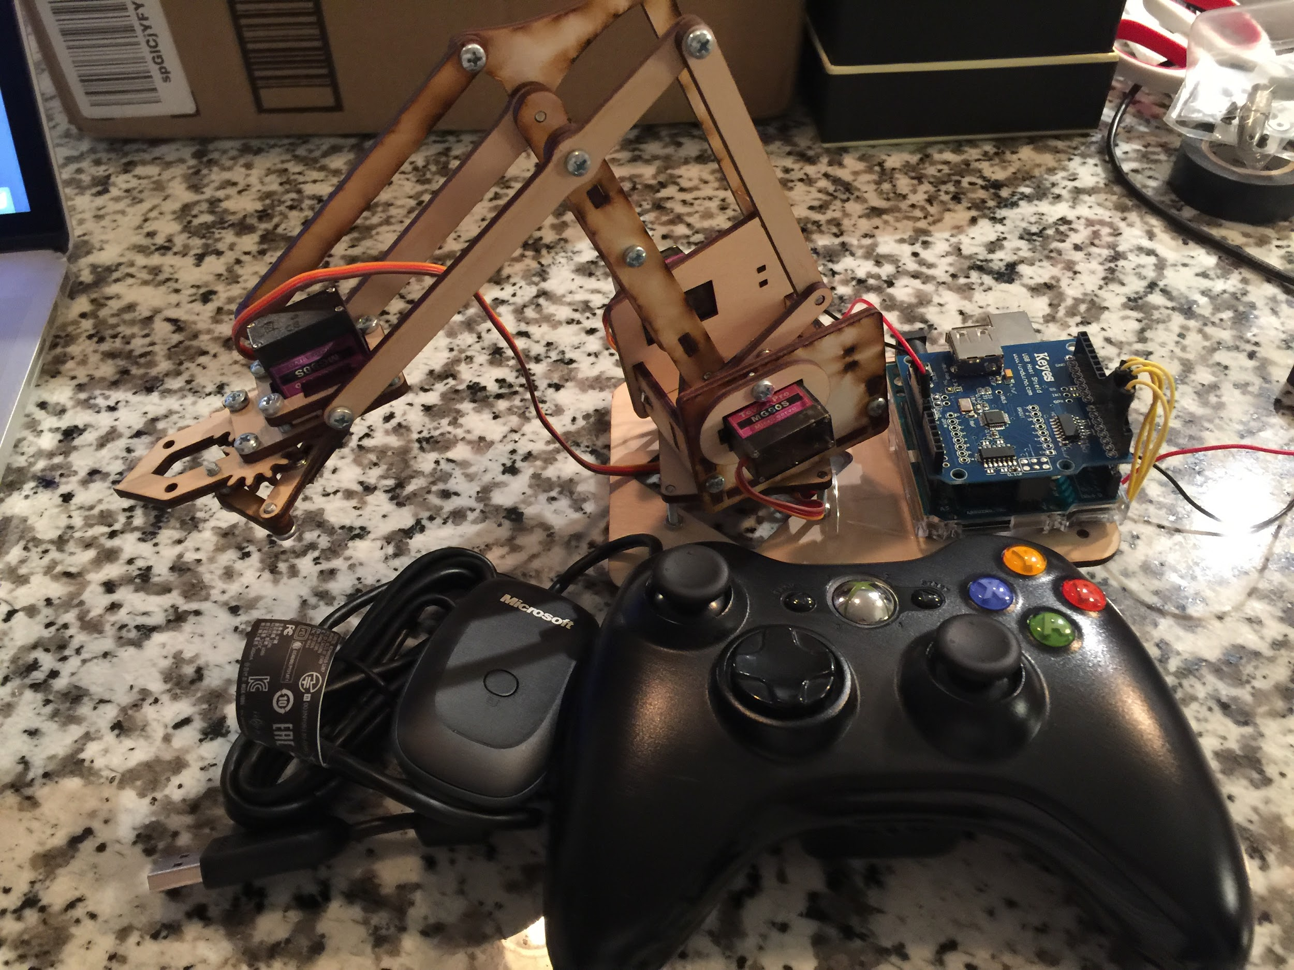
New Robotic Arm Overview
Structure:
Wooden Material & 4 motors
Microcontroller:
Arduino Uno & USB Shield
Control Method:
Xbox360 controller & Receiver

Slide 9
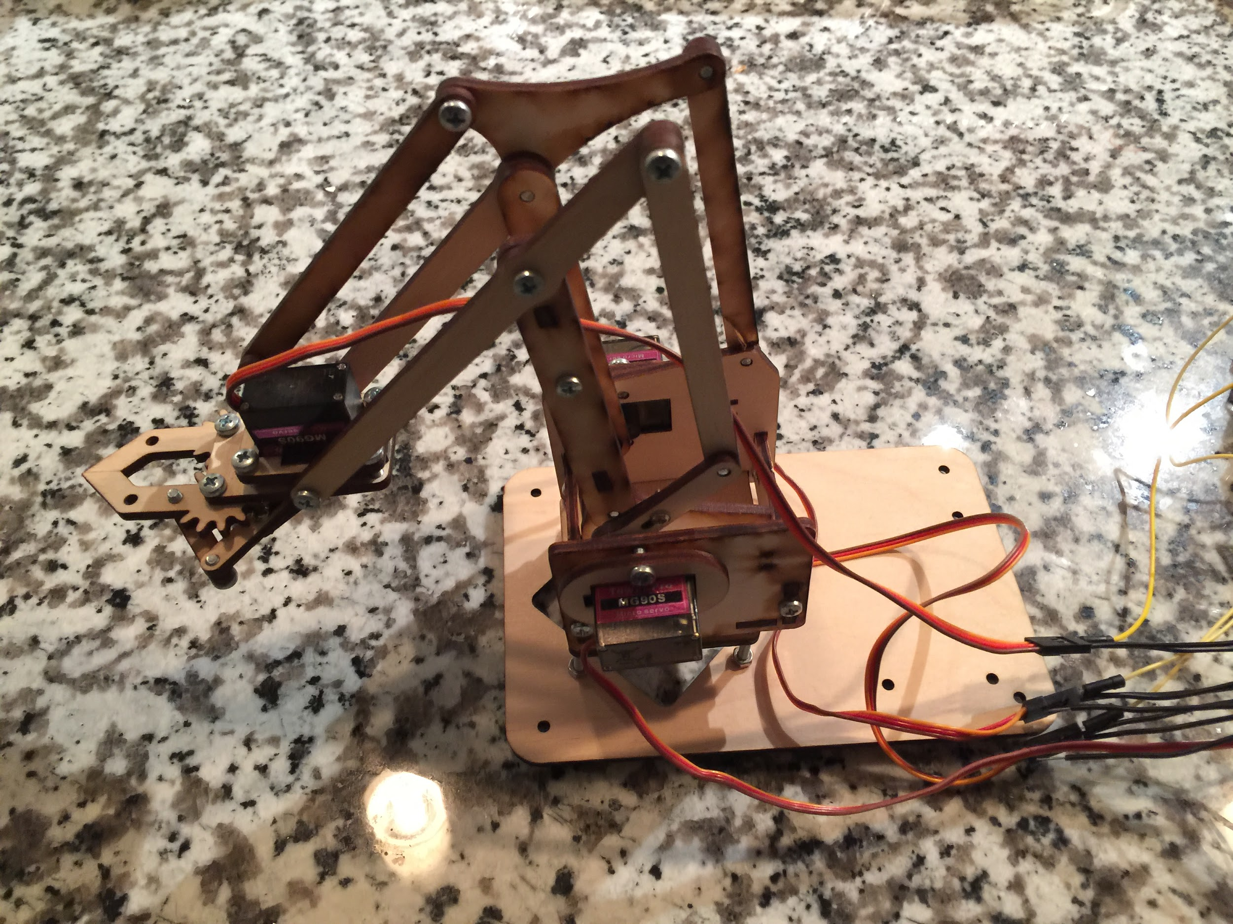
Robotic Arm: Structure
Durable and lightweight
4 degree of freedom
Lifting capacity up to 100g

Slide 10
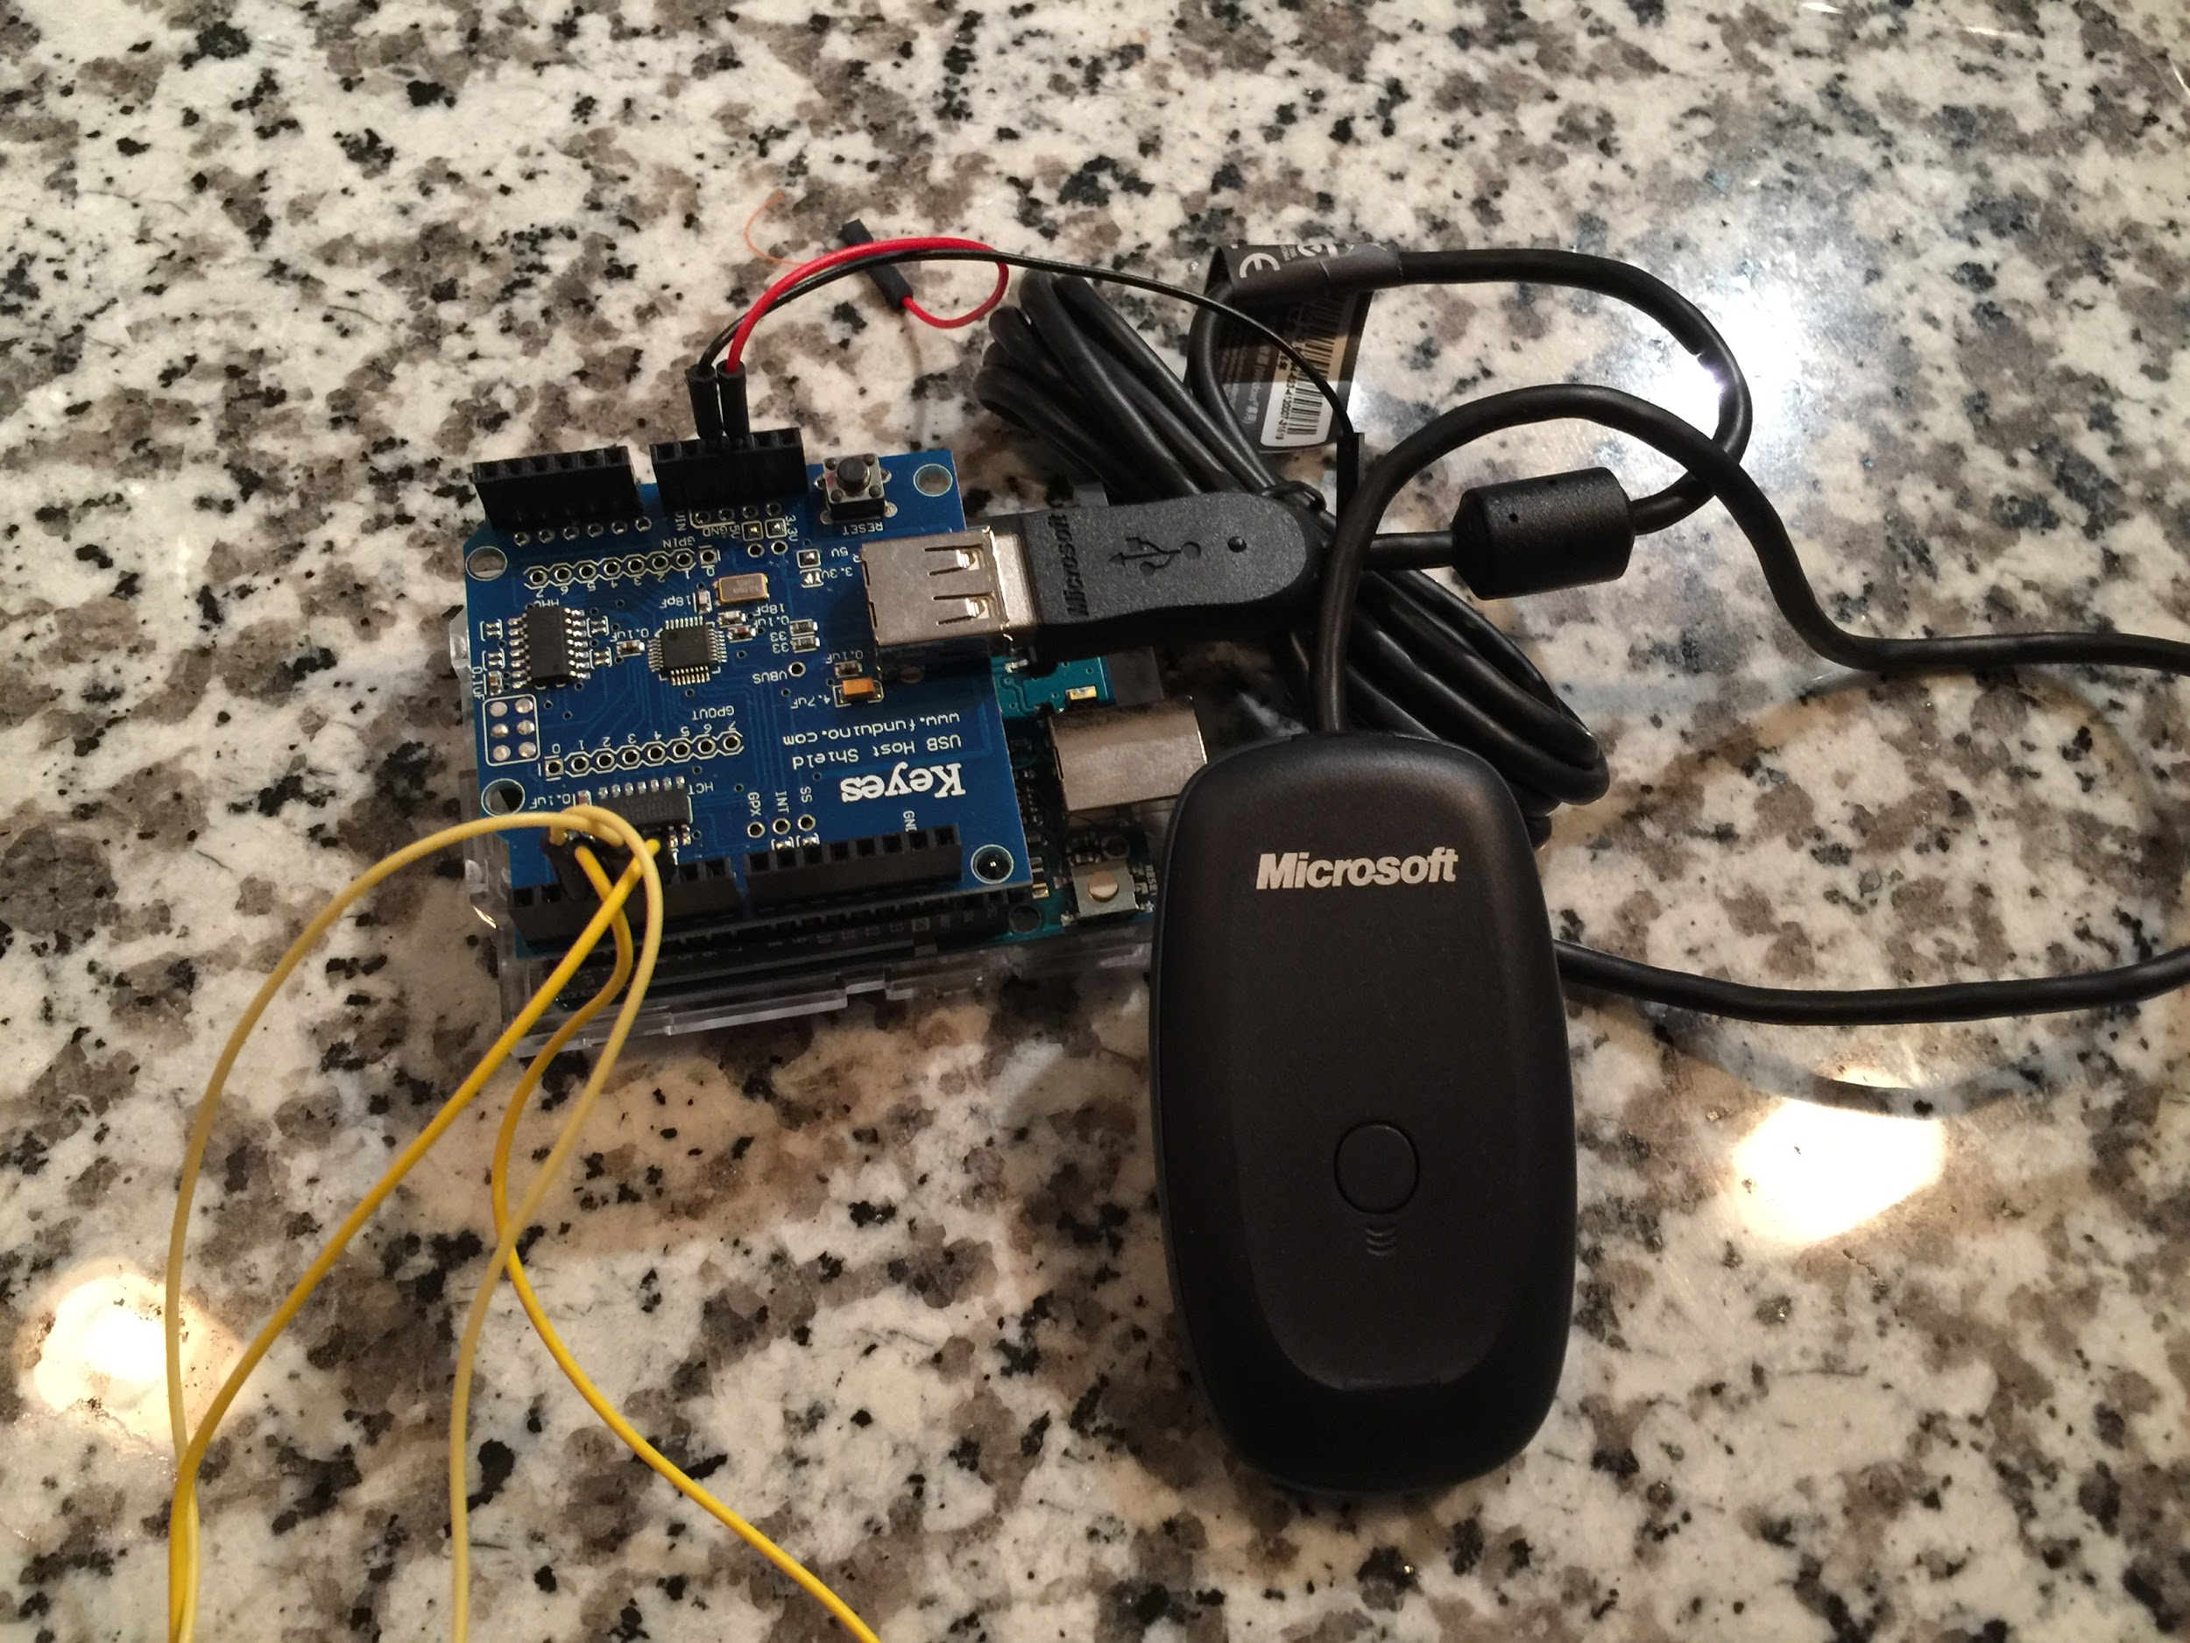
Robotic Arm: Microcontroller
Arduino Uno
Arduino IDE
Built-in Xbox control package
E.g. Xbox.getAnalogHat(LeftHatY,i) Xbox.getButtonClick(R2,i)
USB shield
Required component for 360 receiver
Perfectly attached to Arduino
Connection code: USB Usb; XBOXRECV Xbox(&Usb);
Notes:
getAnalogHat: LeftHatY means the left joystick in Y axis.
ButtonClick: R2 means right trigger. 2 for trigger and 1 for bumper. It can be easily customized.

Slide 11
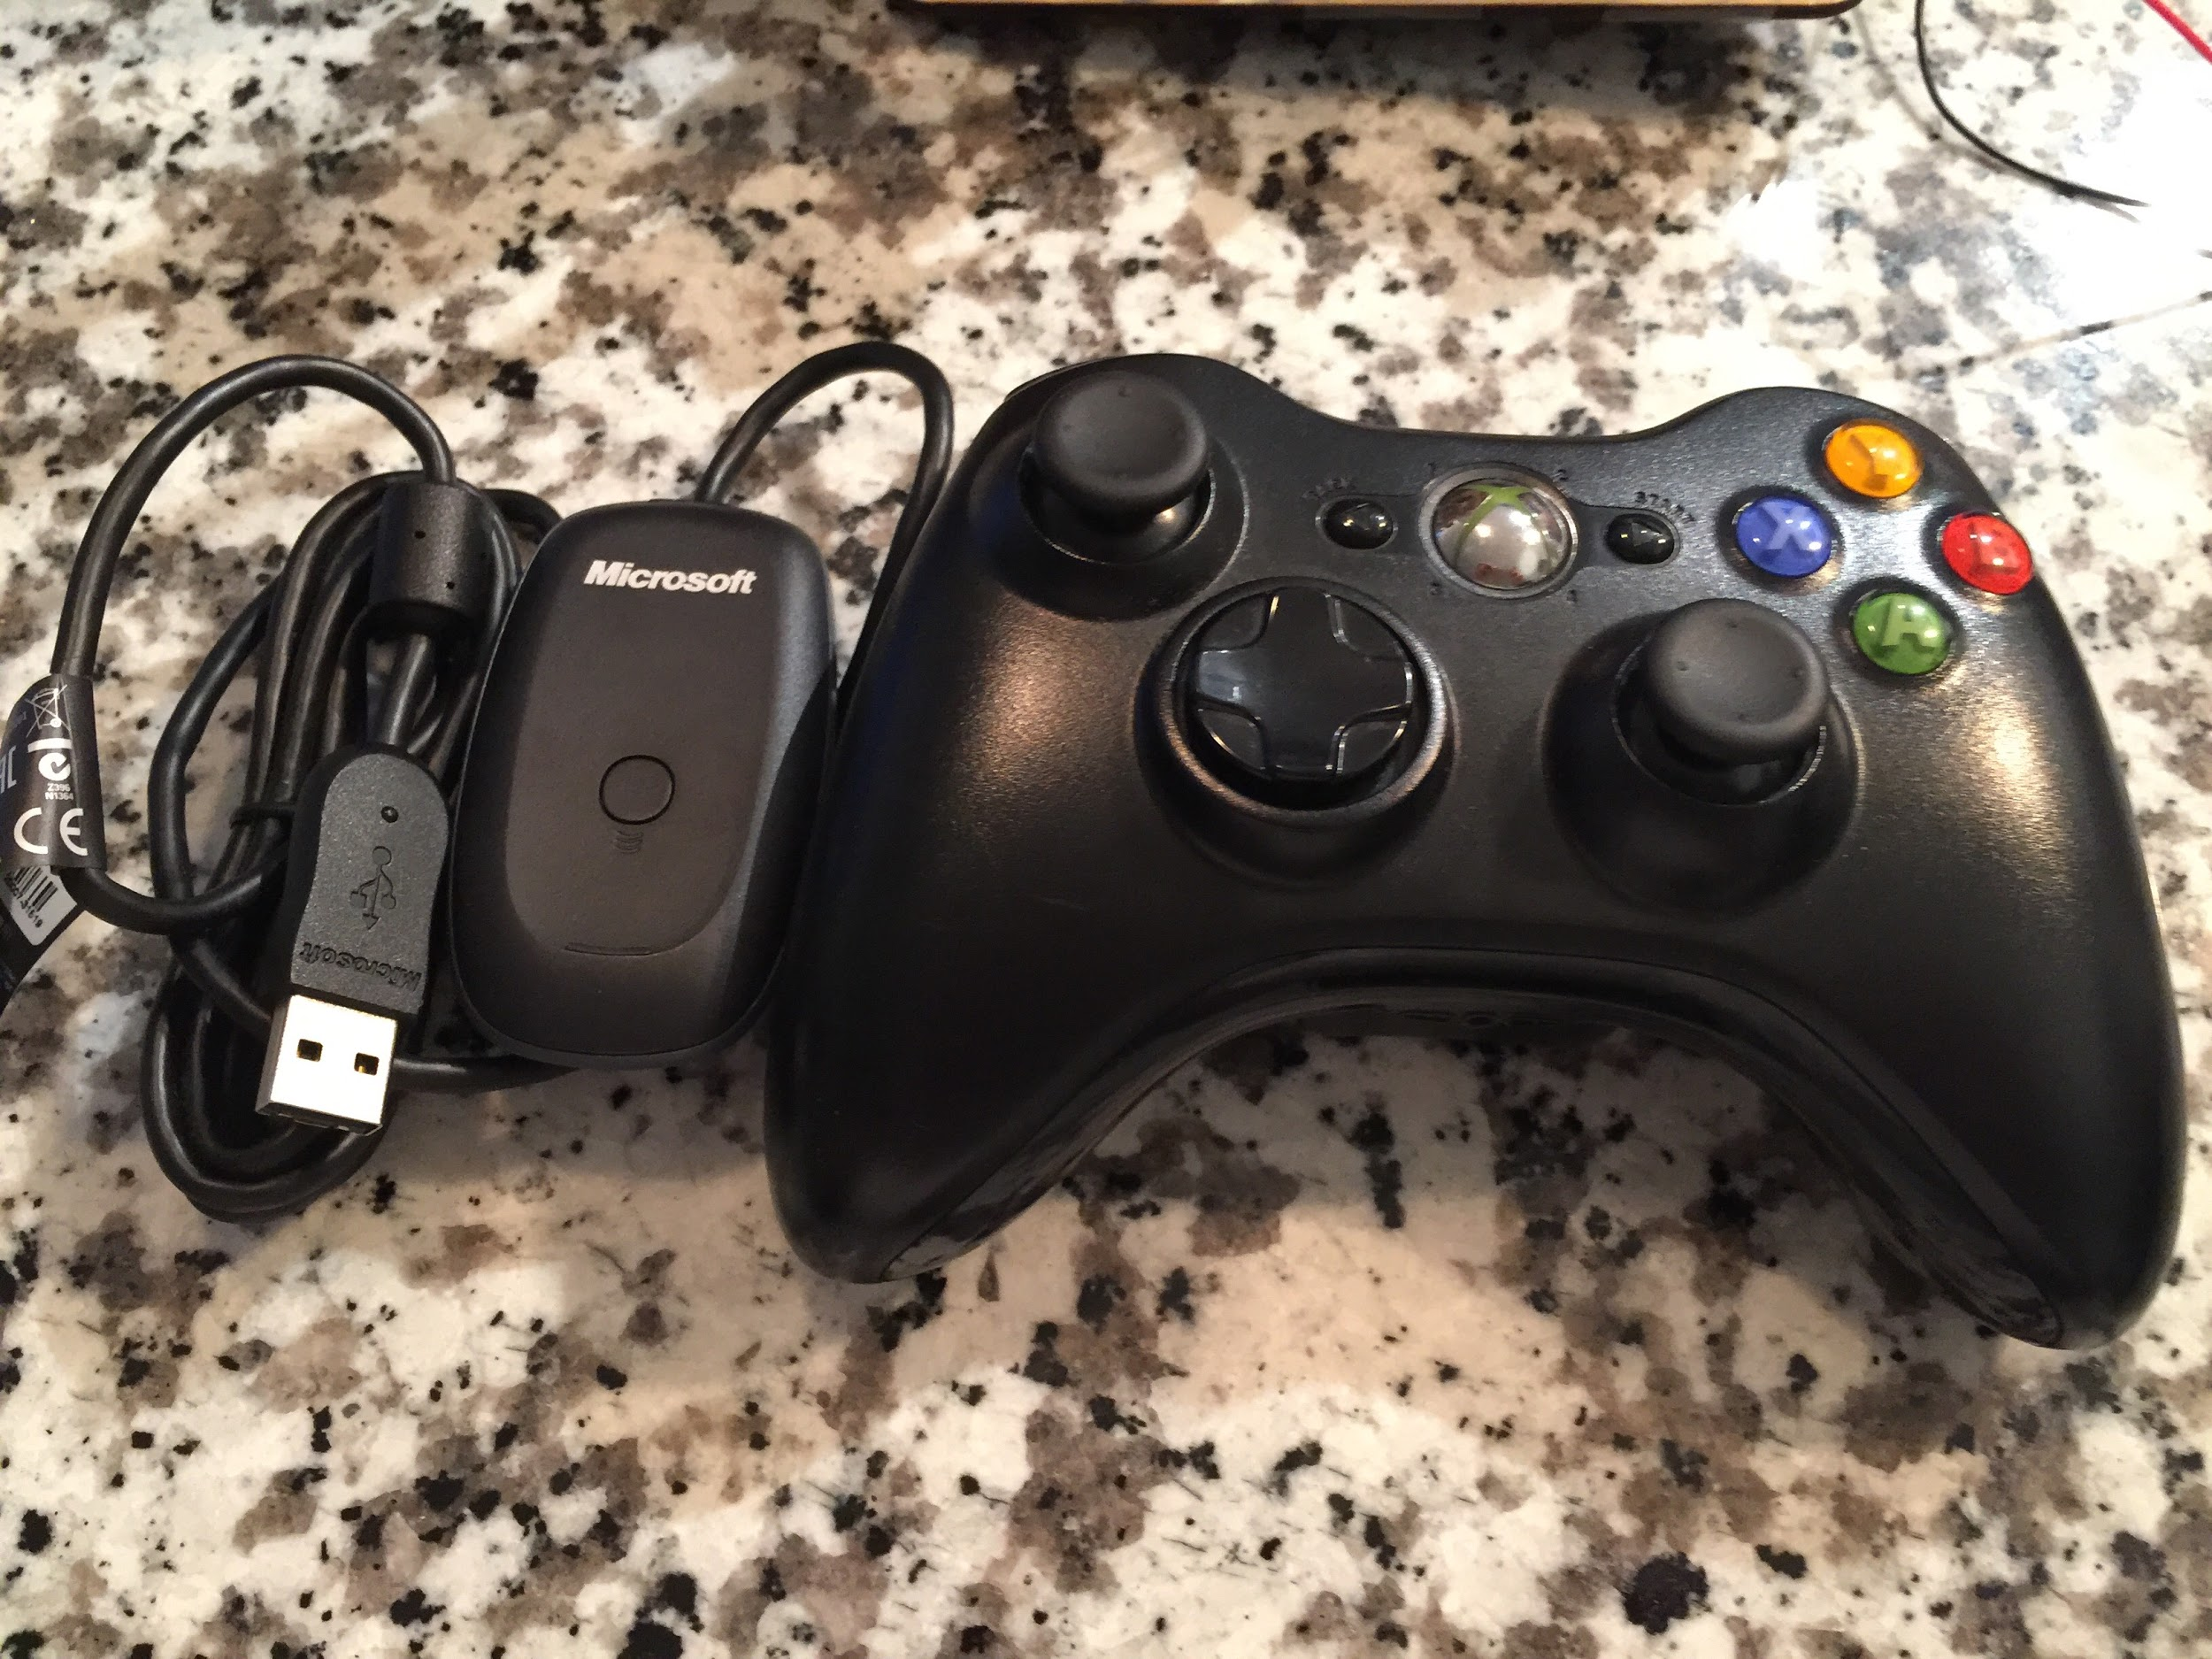
Robotic Arm: Control Method
Xbox 360 Controller
Signal transmitted through 2.4GHz
Signal ranges up to 30 feet
More portable than computer
Wireless Gaming Receiver
Microsoft Xbox 360 Wireless Receiver
Connect to Arduino USB shield
Notes:
Perfect signal transmission between controller and receiver
Through USB 2.0.

Slide 12
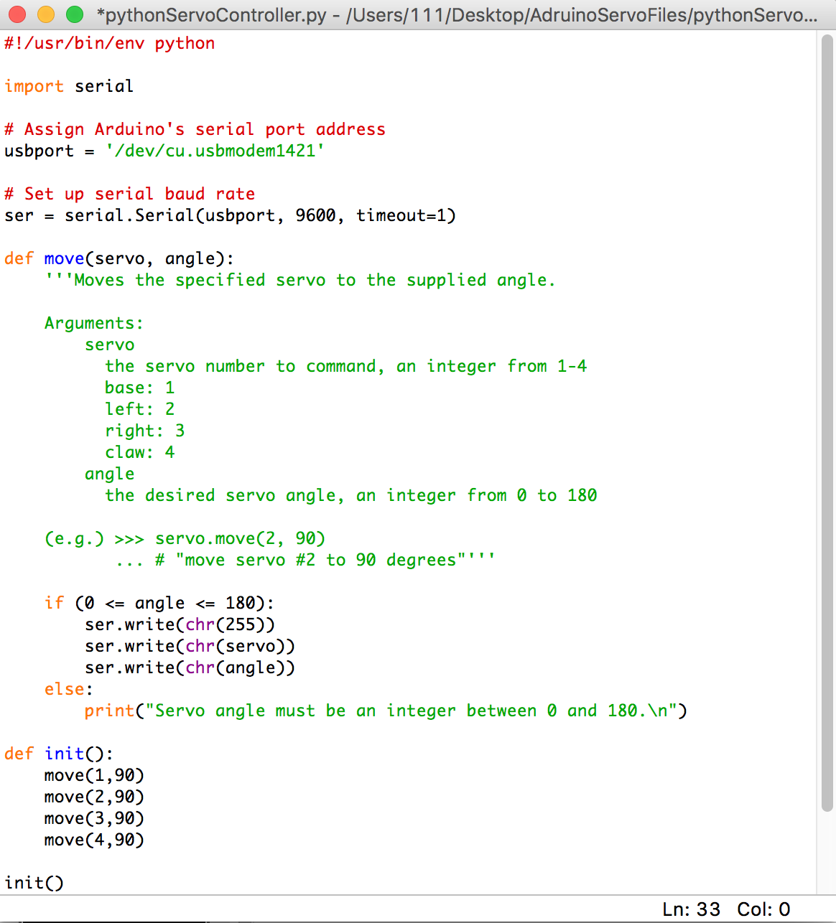
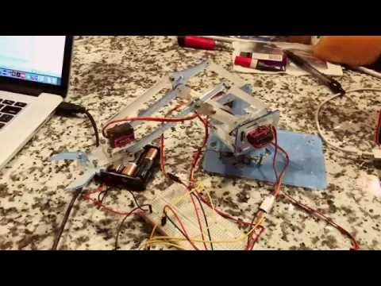
Result from Previous Technique

Slide 13
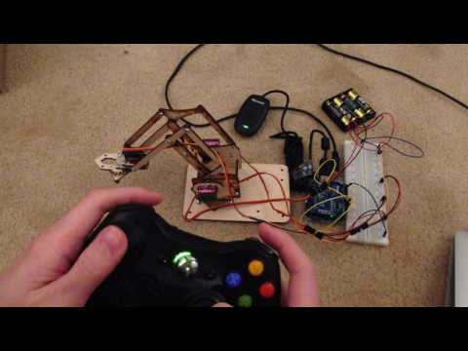
Result from New Technique
Control instructions for Xbox360 controller:
Start(button) : Initialize position
A(button) : Reattach servos
B(button) : Unattach servos
Left/Right Trigger : Base
Left Joystick : Up & Down
Right Joystick : Reach & Retrieve
Notes:
We added A and B buttons, if arm is not in use, we can unattach servos in order to avoid unintentionally touch the controller. Then, if we want to take back the control, we press A button.

Slide 14
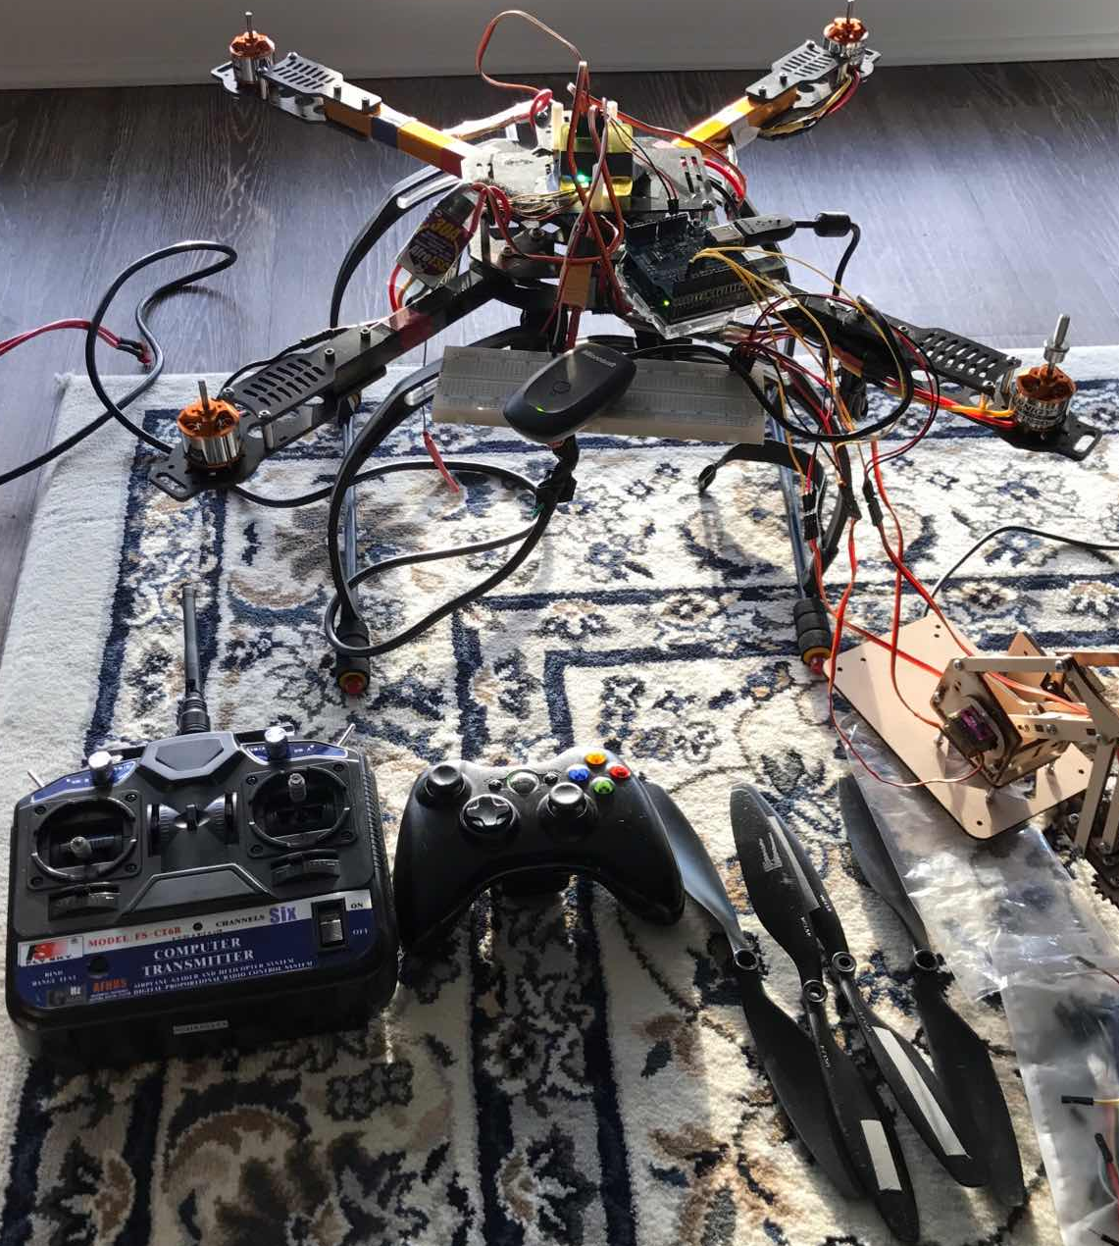
Quadcopter Overview
Microcontroller: Flight Controller
4 Electronic Speed Controller (ESC)
4 Brushless Motors & 4 Propellers
Radio Transmitter & Receiver
Notes:
CC3D: center of the quadcopter has different kinds of sensors
ESC: receive signal/command from flight controller, and drives the motors by providing the appropriate level of electrical power in order to change motors speed

Slide 15
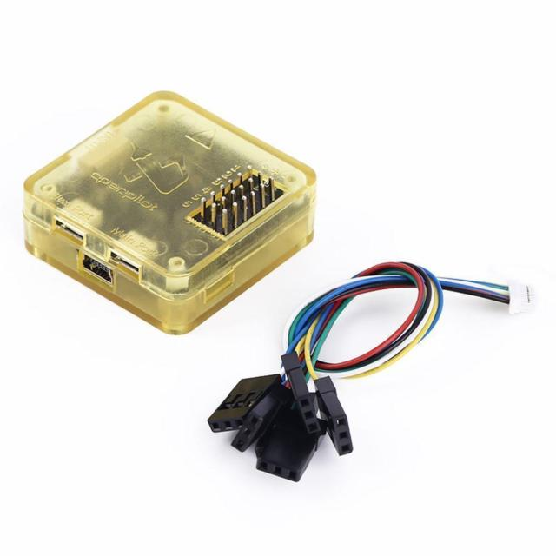
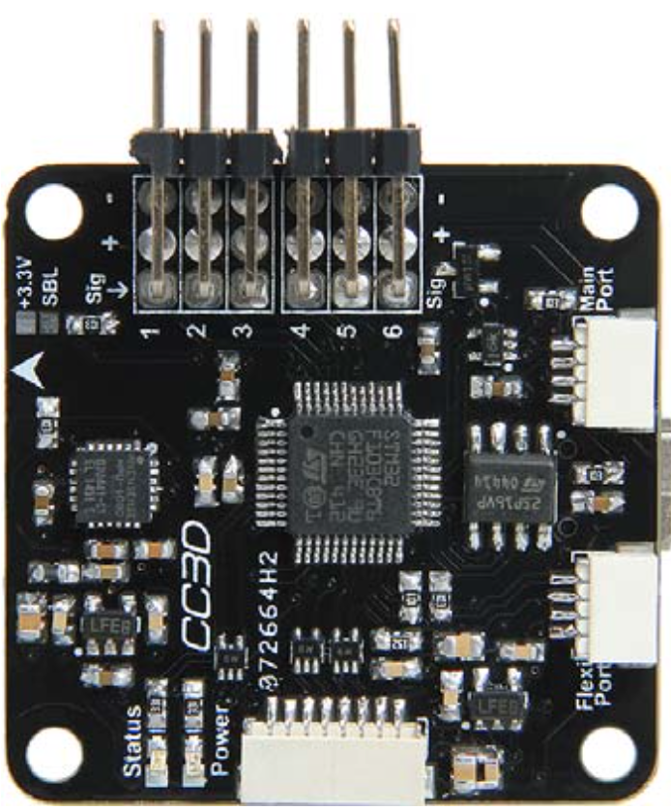
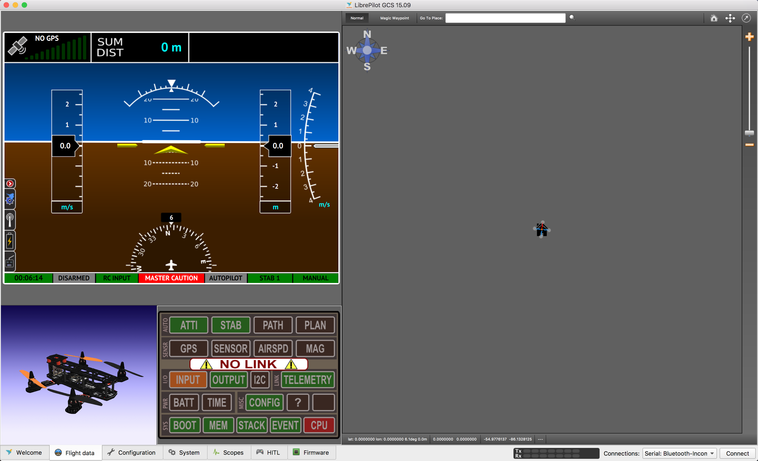
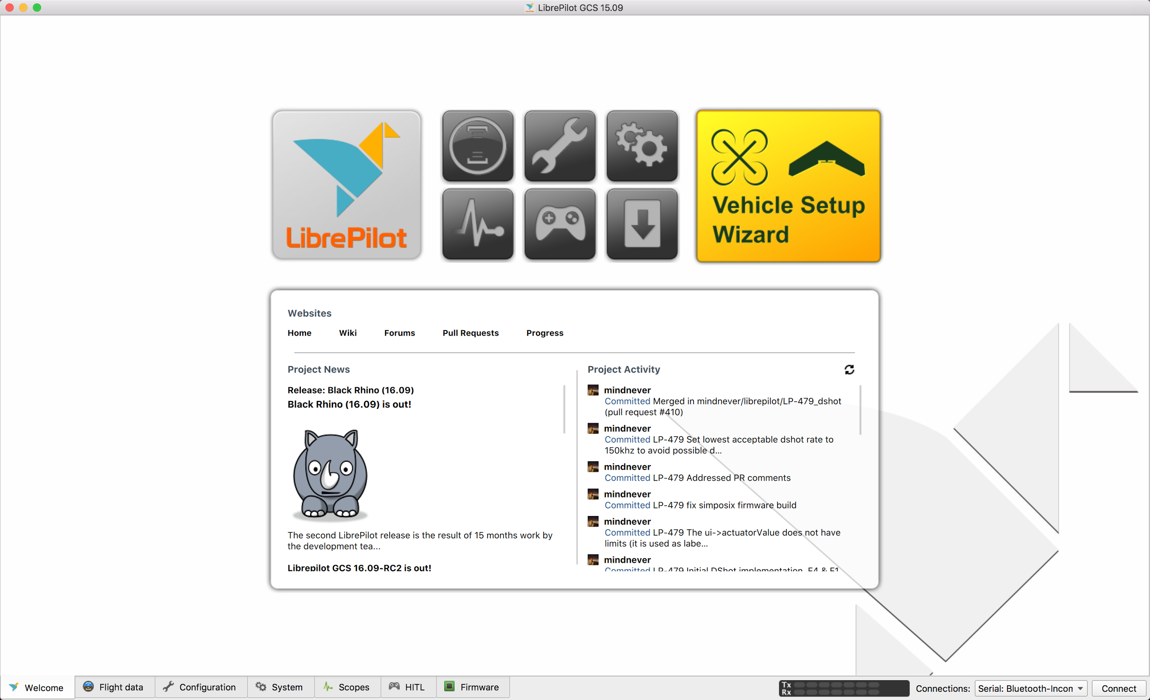
Quadcopter: Flight Controller
Flight Controller: CC3D - 32-bit can run at 72MHz
Sensors: 3-axis Gyroscope & 3-axis Accelerometer
Software: LibrePilot Ground Control Station (GCS)
Notes:
Gyroscope: Dry肉 scope

Slide 16
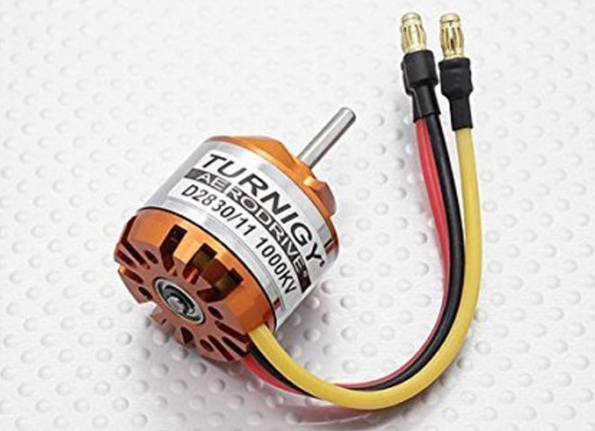
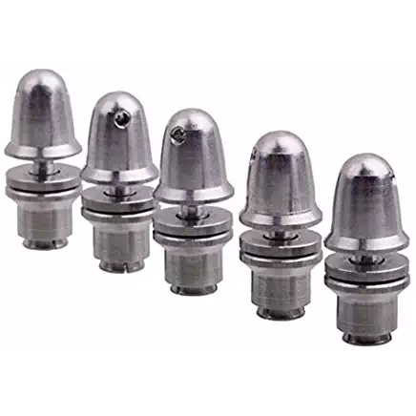
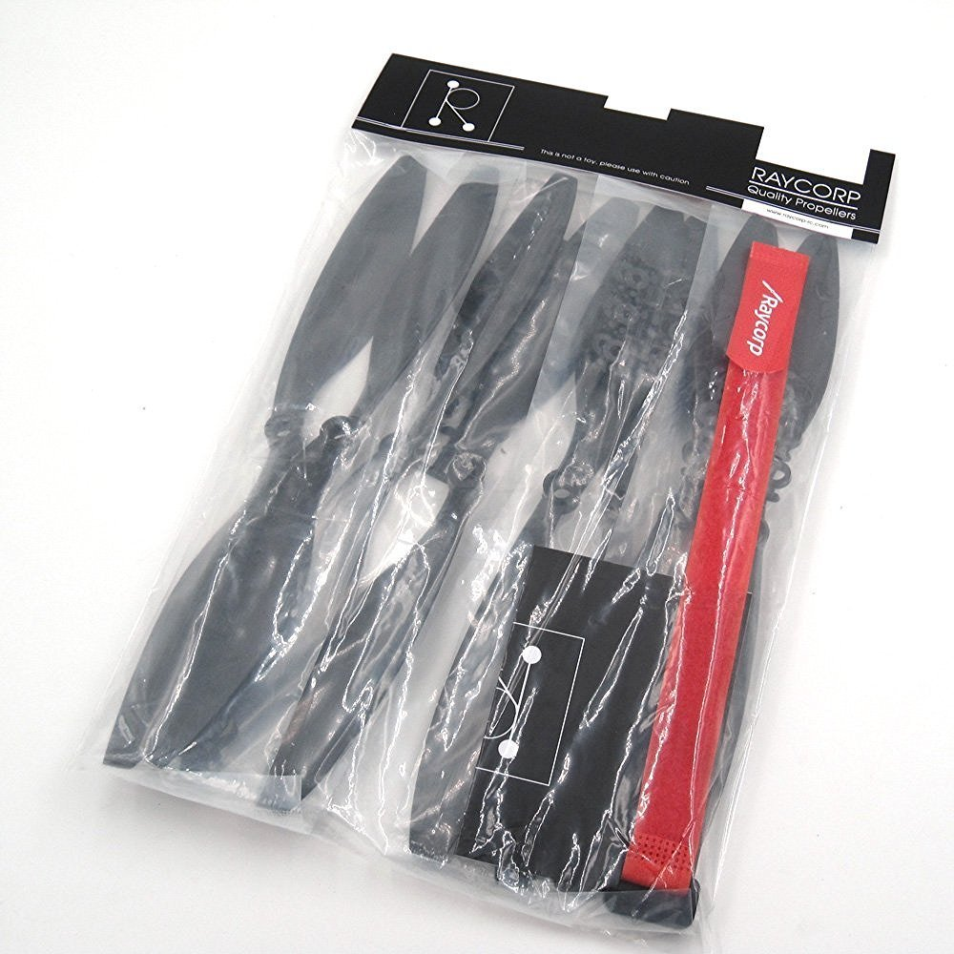
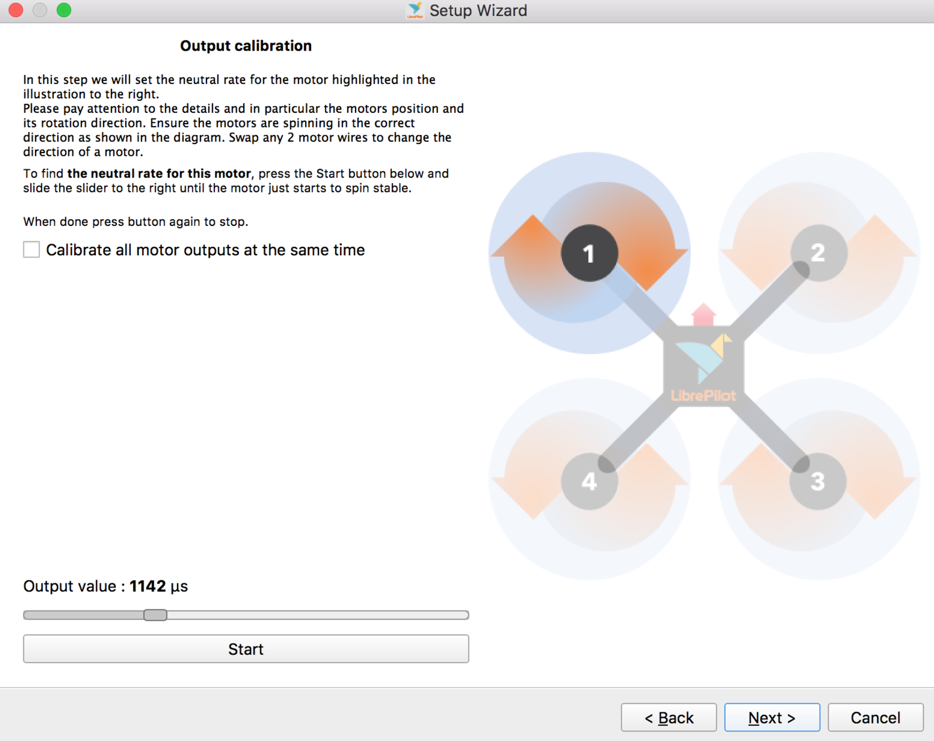
Quadcopter: Motors + Propellers
Motors: 4 Turnigy D2830-11 Brushless Outrunner
Propellers: 2 CW + 2 CCW
Issue: Calibration
Several incidents: 1. Shaft broke 2. Propellers flew off
Notes:
The motors we are using here are 4 Turnigy D2830 brushless outrunner.
Despite the motors are very powerful, we had problems to calibrate these 4 motors to have same output when these motors start spinning. The speed of 4 propellers are different and it can be seen very clearly when the quadcopter started to takeoff.
And also, we had several incidents with the motors and propellers.

Slide 17
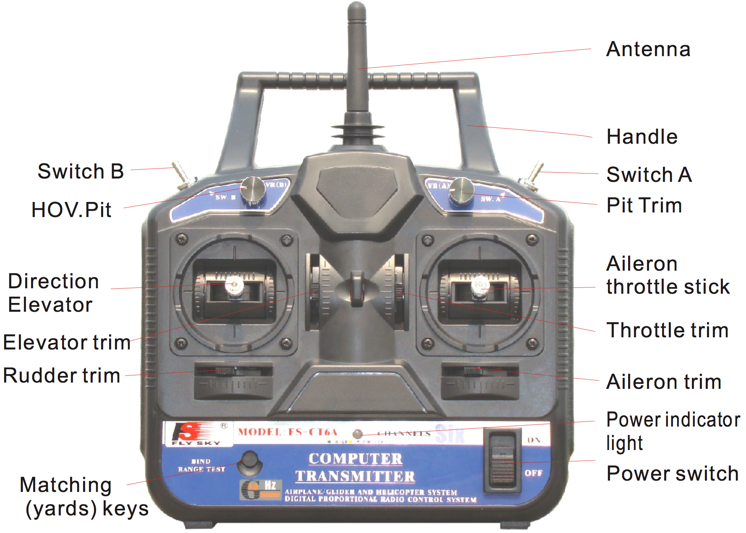
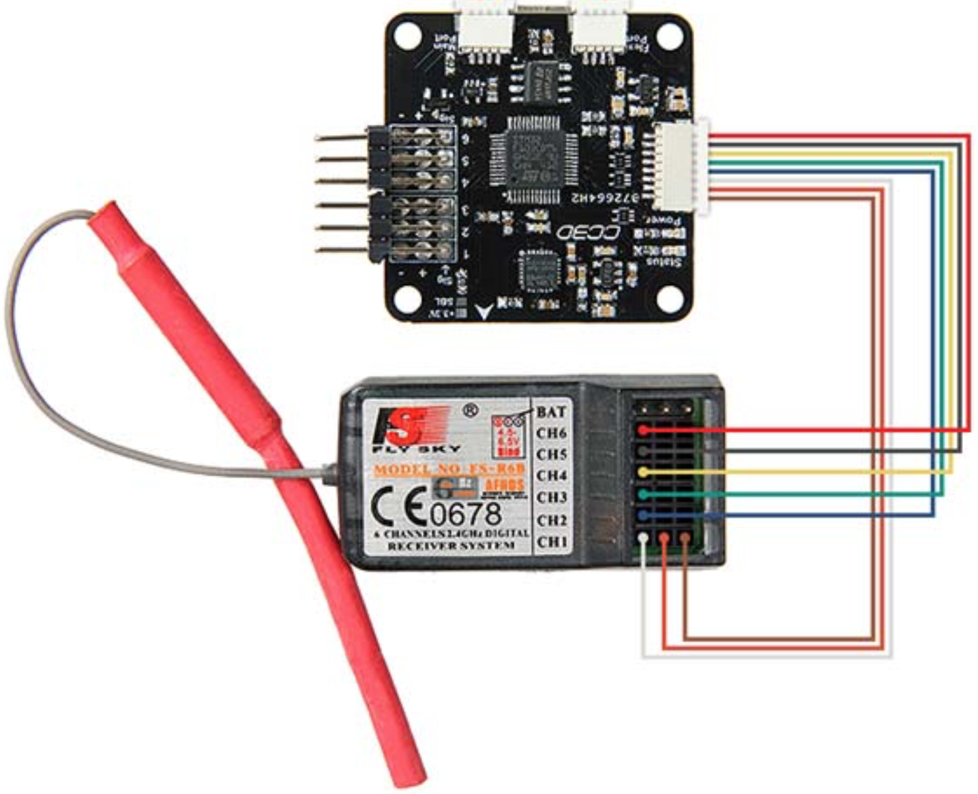
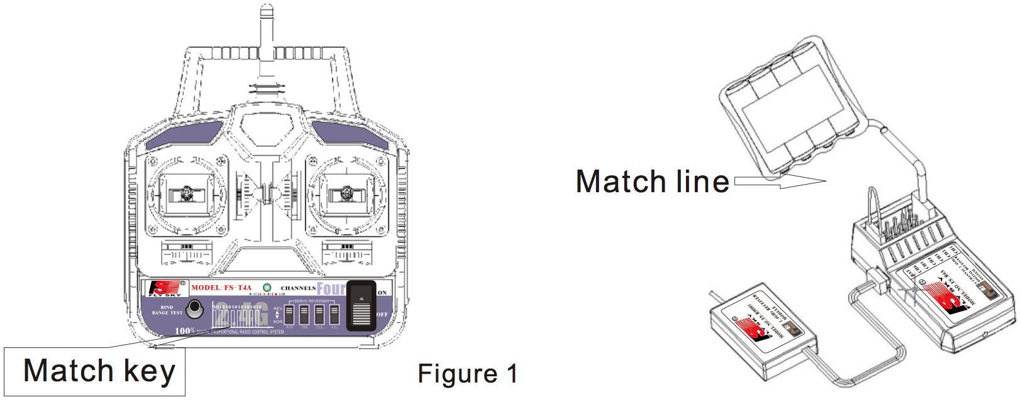
Quadcopter: Transmitter & Receiver
FS-CT6A Radio Transmitter & Receiver Parameters: - Frequency band: 2.4GHz - 6 Channels
Issue solved: Binding

Slide 18
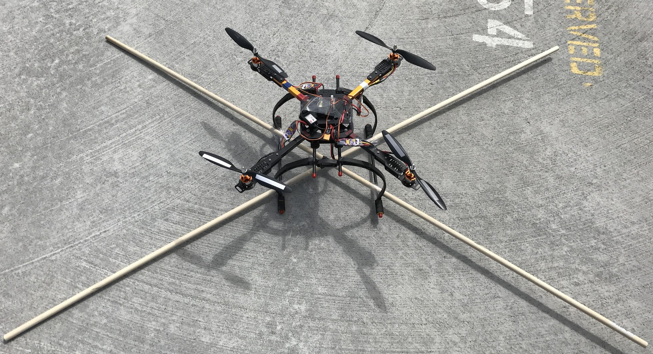
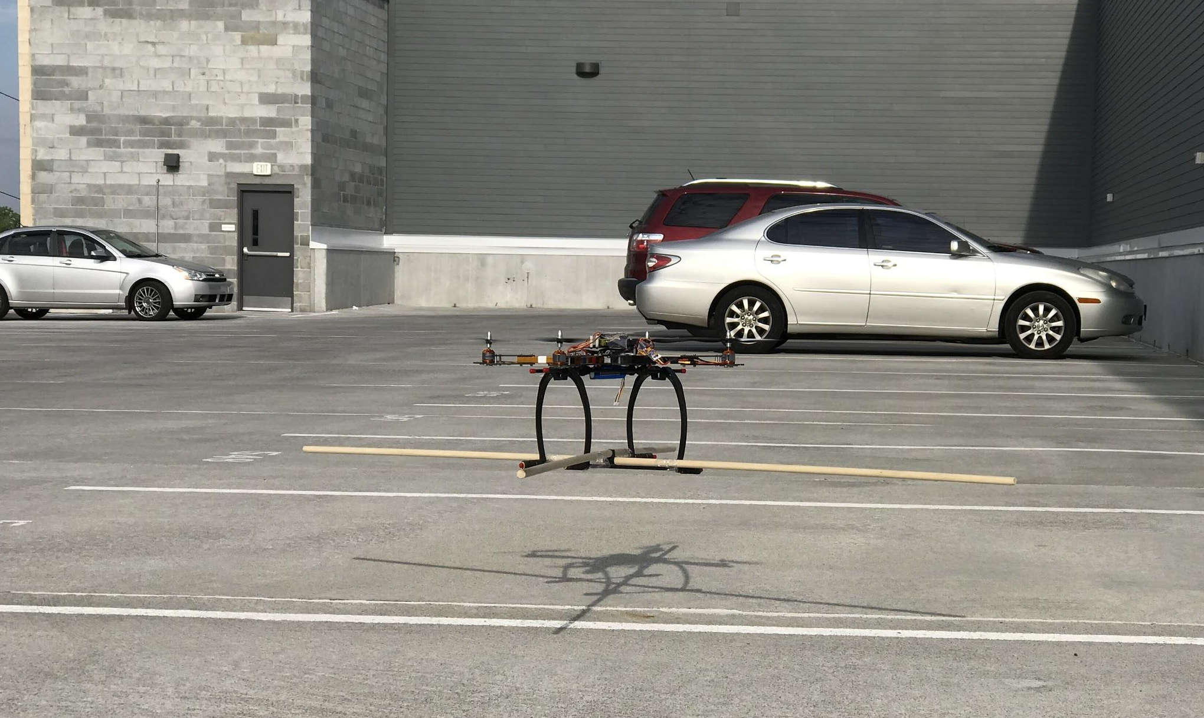
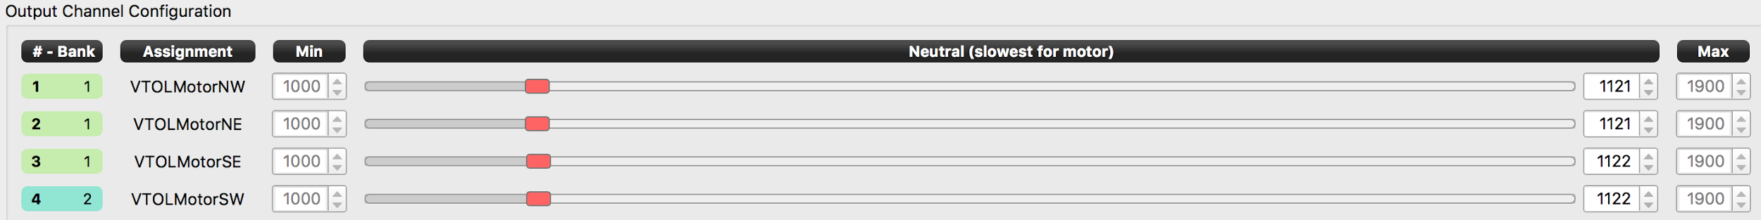
Quadcopter: Fly Testing
Stabilization test: Tight with 2 long light sticks
Issues: Insta-flip on throttles up (instant flip-over on taking off)

Slide 19
Integration of Robotic Arm + Quadcopter
Prototype Demo

Slide 20
Thank you!

